Slide 1
JavaScript 2

Slide 2
Object
Objects are entities with properties and methods and resemble to real life objects.
Properties
specify the characteristics or attributes of an object.
Methods
identify the behavior of an object.
Types Of Objects:
Built-in Objects- pre-defined objects which are already defined. Their
properties and methods need to be called to fulfill a task.
Custom Objects- Are user-defined objects, which the developer creates in the script and defines their properties and methods.

Slide 3
Date Object
The Date object allows you to define and manipulate the date and time values programmatically
Book page no. 370

Slide 4
String Object
Strings in JavaScript are a set of characters that are surrounded by single or double quotes.
These characters can include alphabets, numbers, spaces, and symbols: %, @, &, and so on.
The built-in String object allows you to perform different text operations on them.

Slide 5
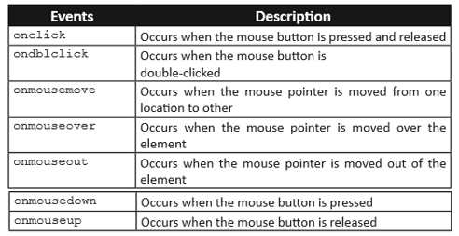
Mouse Events
Mouse events occur when the user clicks the mouse button.

Slide 6
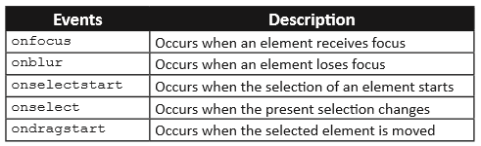
Focus and Selection Events
The focus events determine the activation of various elements that uses the input element. It allows you to set or reset focus for different input elements. The selection events occur when an element or a part of an element within a Web page is selected.

Slide 7

DOM
The document object represents your web page.
The DOM defines a standard for accessing documents.
Through DOM you can update, access and style your document.

Slide 8
Finding HTML Elements
Method Description
document.getElementById(id) Find an element by element id
document.getElementsByTagName(name) Find elements by tag name
document.getElementsByClassName(name) Find elements by class name
document.getElementsByName(name) Find elements by name

